Slide 1

Mobile Computing Technology
February 15, 2024

Slide 2
Learning Objectives
What are partitions
What is the overall flow of the bootstrap program
What is the Init process
What are Android System Configurations
Explain the purpose and structure of the Android Backup Manager / Service
Android Auto Backup – use it via the CLI
Key-Value Backup

Slide 3
Review
Partitions: divide a storage device into one or more groups:
The operating system can treat each partition as though it were a separate device.
Example: one partition can hold a file system containing a copy of the operating system’s executable code, another a file system containing the user files.
We discussed Android core partitions previously
Notes:
Silberschatz, 10eth edition

Slide 4
Review
To partition a device into one or more groups:
The fdisk command is used to manage partitions on storage devices. At boot time, the storage device has its partition information read, and the operating system then creates device entries for the partitions (e.g. under /dev/block/)
A configuration file tells the operating system to mount each partition containing a file system at a specified location (mount point) and to use mount options such as read-only.
Note: Mounting a file system is making the file system available for use by the system and its users.
Notes:
“”Android gives special programs (e.g., the camera driver) the ability to use a partition as a large sequential array of logical blocks, without any file-system data structures. This array is sometimes called the raw disk, and I/O to this array is termed raw I/O.
Some database systems prefer raw I/O because it enables them to control the exact location where each database record is stored.
Raw I/O bypasses all the file-system services, such as file names and directories.
We can make certain applications more efficient by allowing them to implement their own special-purpose storage services on a raw partition, but most applications use a provided file system rather than managing data themselves.””
Silberschatz, 10eth edition
The `/etc/fstab` file (standing for "file system table") is a system configuration file commonly found on Unix and Unix-like operating systems. It contains information about disk partitions and how they should be mounted into the file system.
In Android, the `/etc/fstab` file typically specifies mount points for various partitions like system, data, cache, and others, along with mount options such as read-only or read-write. This file helps the Android system understand how to mount different partitions during the boot process and other system operations.

Slide 5
Review
A bootable file system:
The partition information also indicates if a partition contains a bootable file system (containing the operating system).
The partition labeled for boot is used to establish the root of the file system.
Once it is mounted, device links for all other devices and their partitions can be created.
Generally, a computer’s “file system” consists of all mounted volumes.
On Windows, these are separately named via a letter (C:, D:, E:).
On Linux, at boot time the boot file system is mounted, and other file systems can be mounted within that tree structure
Notes:
Silberschatz, 10eth edition

Slide 6
The Boot Process
When Android is powered up or rebooted—it must have an initial program to run – The bootstrap loader or boot loader
the bootstrap is stored in a flash memory firmware on the system and mapped to a known memory location.
It can be updated by product manufacturers as needed.
It initializes all aspects of the system, from CPU registers to device controllers and the contents of main memory.
Notes:
“”
booting The procedure of starting a computer by loading the kernel.
bootstrap: The set of steps taken at power-on to bring the system to full operation.
bootstrap loader: The small program that loads bootstrap program which loads the kernel as part of the bootstrap procedure. In Android, a bootloader is a vendor-proprietary image responsible for bringing up the kernel on a device. The bootloader guards the device state and is responsible for verifying the integrity of the boot and recovery partitions before moving execution to the kernel.
bootstrap program: The program that allows the device to start running by initializing hardware and loading the kernel
boot block: A block of code stored in a specific location on disk with the instructions to boot the kernel stored on that disk.
boot disk: A disk that has a boot partition and a kernel to load to boot the system. A device that has a boot partition and can store an operating system for booting the computer.
boot partition: A storage device partition containing an executable operating system.
Firmware: Software stored in ROM or EEPROM for booting the system and managing low level hardware.
Running: refers to the state of the operating system after boot when all kernel initialization has completed and system services have started. In general, the system state after booting and before crashing or
being shut down.””
Silberschatz, 10eth edition

Slide 7
The Boot Process
The bootstrap loader
brings in a full bootstrap program from secondary storage. The full bootstrap program is stored in the “boot blocks” at a fixed location on the boot partition.
A storage device that has a boot partition is called a boot disk or system disk.
Once loaded, the bootstrap proceeds as follows
The kernel is loaded into memory and started.
The kernel initializes hardware.
The root file system is mounted.
Notes:
“”
The Bootstrap program
Runs diagnostics to determine the state of the machine
For example, inspecting memory and the CPU and discovering devices.
If the diagnostics pass, the program can continue with the booting steps.
initializes all aspects of the system, from CPU registers to device controllers and the contents of main memory.
Sooner or later, it starts the operating system and mounts the root file system. It is only at this point is the system said to be running.
Note that if the boot loader does not understand a particular file-system format, an operating system stored on that file system is not bootable. This is one of the reasons only some file systems are
supported as root file systems for any given operating system.
The bootstrap program contains the operating-system kernel and sometimes other system files. It mounts the root partition at boot time.””
Silberschatz, 10eth edition

Slide 8
The Boot Process
Linux Boot Process
During the boot process, a temporary RAM file system, known as initramfs created.
This file system contains necessary drivers and kernel modules that must be installed to support the real root file system (which is not in main memory).
Once the kernel has started and the necessary drivers are installed, the kernel switches the root file system from the temporary RAM location to the appropriate root file system location.
Finally, Linux creates the systemd or init process, the initial process in the system, and then starts other services (for example, a web server and/or database).
Notes:
In Android 10 and higher, devices must specify fstab entries for early mounted partitions using an fstab file in the first stage ramdisk.
A configuration flag in the fstab file indicates that a specific partition will be mounted by the first stage init. Likewise, a flag will specify the partition that must be initialized by the “first stage init” before mounting other partitions. Under the emulated Android system that we use for our exercises, /system is mounted first.
Devices running Android 10 and higher must place the fstab file in the ramdisk and in the vendor partition.
All devices must place a copy of the fstab file into /vendor/etc. This is because the first stage init frees the ramdisk after it completes the early mounting of partitions and performs a switch root operation to move the mount at /system to /.
Any subsequent operations needing to access fstab files must therefore use the copy in /vendor/etc.
Try on the shell (connected to the emulator)
>> cat /vendor/etc/fstab.ranchu

Slide 9
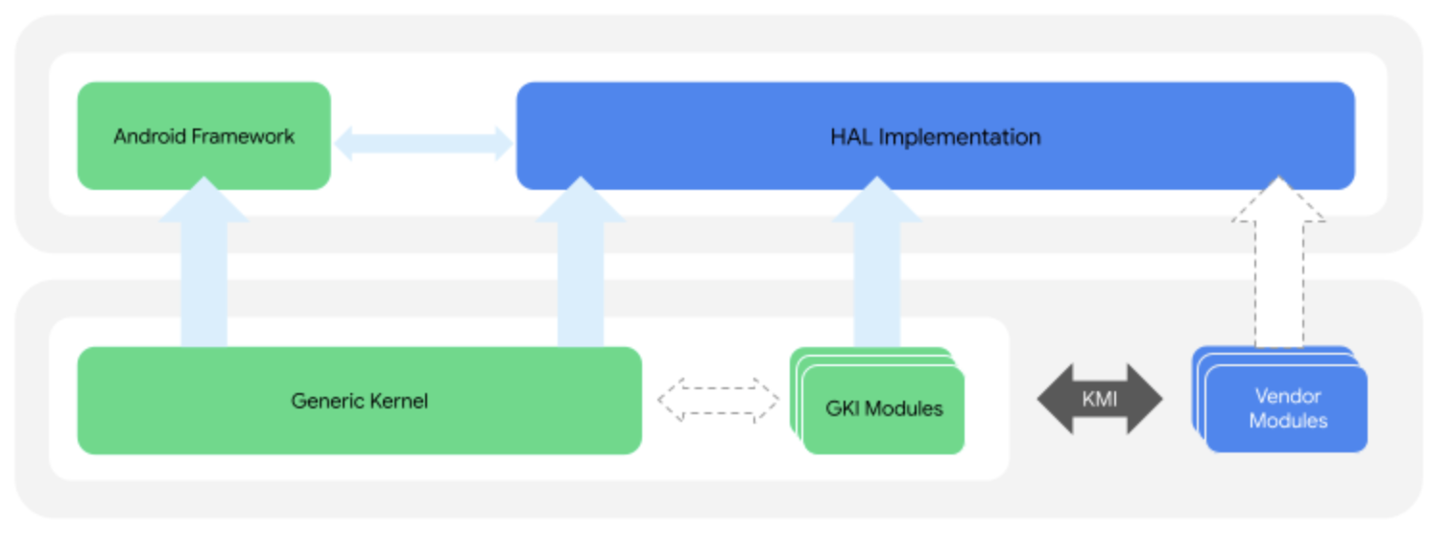
The Boot Process
Android Boot Process
The most common Android boot loader is LK (for “little kernel”).
The bootloader loads the Generic Kernel Image (GKI) .
The GKI kernel is a single-kernel binary plus associated loadable modules per architecture. It is generic core kernel that works with all Android devices.
While Linux discards the initramfs once all necessary drivers have been loaded, Android maintains initramfs as the root file system for the device.
Once the kernel has been fully loaded and the root file system mounted, Android starts the init process and creates a number of services before displaying the home screen.
Notes:
GRUB is an open-source bootstrap program for Linux and UNIX systems. Boot parameters for the system are set in a GRUB configuration file, which is loaded at startup. Boot parameters for the system are set in a GRUB configuration file, which is loaded at startup. GRUB allows changes to be made at boot time, including modifying kernel parameters. The boot process for mobile systems is slightly different from that for traditional PCs. For example, although its kernel is Linux-based, Android does not use GRUB and instead leaves it up to vendors to provide boot loaders.
Silberschatz, 10eth edition
GKI is the core kernel (vendor independent). Hardware and Vendor-dependent parts of the IS (drivers for specific hardware, camera, board support) are avaialbe as loadable vendor modules that are started / loaded into the operating system during the bootstrap.
The GKI contains the core kernel with code common across all devices and modules developed by Google that can be dynamically loaded on devices where applicable.
KMI is an interface between the GKI kernel and vendor modules allowing vendor modules to be updated independently of the GKI kernel.
A vendor module is a hardware-specific module developed by a vendor (e.g., Samsung) and that contains System-on-Chip and device-specific functionality. A vendor module is a type of dynamically loadable kernel module.
https://source.android.com/docs/core/architecture/kernel/generic-kernel-image
Here's an example bootloader flow:
Load and initialize memory.
Verify the device
Verify the boot partition
Load the boot images, such as boot.img, vendor_boot.img, init_boot.img, and other proprietary vendor boot images. These boot images contain the kernel and ramdisk images.
Load the kernel into memory as a self-executable compressed binary. The kernel decompresses itself and starts executing into memory.
Load ramdisks and the bootconfig section into memory to create initramfs.
Bootloader can ensure that all executed code comes from a trusted source.
Source: https://source.android.com/docs/core/architecture/bootloader

Slide 10
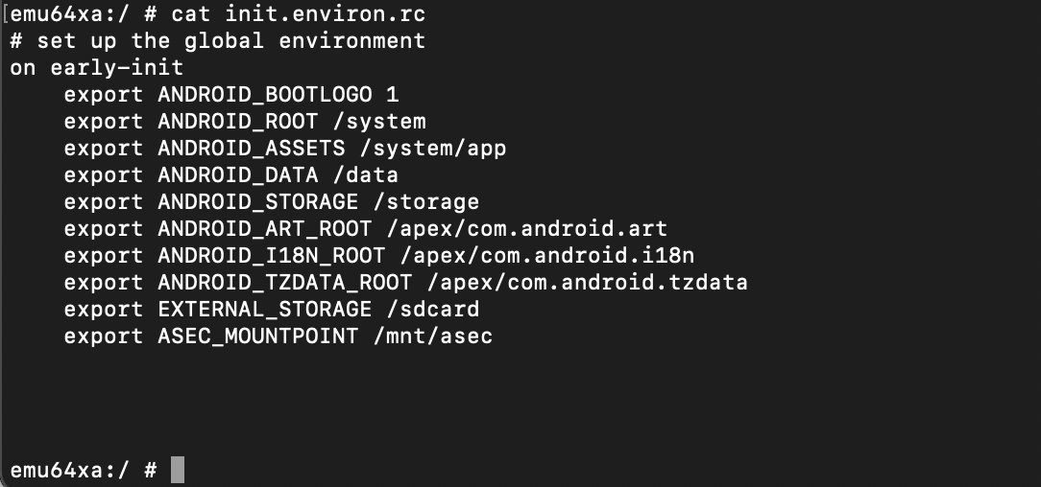
Init
All UNIX systems have a special process, a process which is the first to spring into existence in user-mode when the kernel has finished booting,
starting up the system and
serving as the parent of all other processes and adopting orphan processes
Binaries available under /init
As a binary, /init is statically linked
Configured via .rc files
Provides read access to properties to all processes on the system
Notes:
The following explanations were created by ChatGPT and verified for correctness by the course instructor:
I)
The process init is configured using the files /init.rc and any file (commonly init.hardware.rc and init.usb.rc (sometimes init.hardware.usb.rc)
In Android, the `/init` directory typically contains various executable files and scripts that are essential for the initialization and boot process of the system. Here are some common contents you might find in the `/init` directory:
1. **init**: This is the executable binary for the `init` process, which is the first process started by the Android kernel during system boot. It reads the `init.rc` file and executes the commands specified therein.
2. **init.rc**: This file is a script written in Android-specific syntax that defines the initial setup and configuration of the Android system. It includes instructions for mounting filesystems, starting essential services, setting up permissions, and more. Note, this file may be found directly under the root directory instead of under /init/
3. ***.rc files**: Apart from `init.rc`, there may be additional `.rc` files in the `/init` directory or its subdirectories. These files contain configurations for specific services or components of the Android system.
4. **Other executable files and scripts**: Depending on the specific Android device and its configuration, you might find other executable files or scripts in the `/init` directory that are necessary for the boot process or system initialization.
These contents may vary slightly depending on the Android version and any customizations made by device manufacturers or ROM developers.
Exercies:
>> explore the /etc/init directory using
ls –l /etc/init
II)
In Android, the `init.environ.rc` file is another script file located in the root directory of the Android file system, typically at `/init.environ.rc`. This file is read by the `init` process during system boot, and it is used to set up environment variables that are available to various processes and services throughout the system.
The `init.environ.rc` file contains definitions for environment variables and their values. These variables can be referenced by other scripts, services, or applications running on the Android system. Environment variables are commonly used to provide configuration information, specify paths to important directories, define system properties, and more.
Overall, the `init.environ.rc` file plays a crucial role in initializing the environment for the Android system during the boot process.
Try in your device shell
>> cd /
>> cat init.environ.rc
III)
The Android System Properties provide a globally accessible repository of configuration settings.
/system/default.prop is a configuration file that contains system properties (such as build ID, version, model, manufacturer) used during the boot process. It is a plain text file that defines various properties such as build properties, device configurations, and system settings.

Slide 11
Backup & Recovery
Applications need an ability to save and recover their configuration and data,
Users want the ability to backup the entire device to a well known, bootable configuration or a system checkpoint which can be rolled back to in case of a crash.

Slide 12
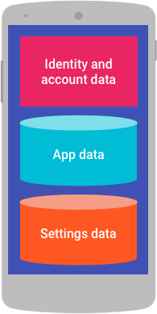
Backup & Recovery
Android BackupManager is a framework service which provides both per-application backups, as well as full backups of all apps

Slide 13
Backup & Recovery
The important data to back up for your users is their identity data, user-generated app data, and settings data
https://developer.android.com/guide/topics/data/backup
Notes:
“”App data can include user-generated content, such as text, images, and other media.
Setting data are settings that a user explicitly sets in your app's UI, as well as transparent data, such as a flag indicating whether a user has seen a setup wizard.
Flags indicating whether the user has turned notifications and ringtones on or off.
Boolean flags that indicate whether the user has seen welcome screens or introductory tooltips
Restore settings data to preserve a returning user's personalized preferences on a new device.
Android provides two ways for apps to back up their data to the cloud: Auto Backup for Apps and key-value backup. Auto Backup, which is available on Android version 6.0 and higher, preserves data by uploading it to the user's Google Drive account. Auto Backup includes files in most of the directories that are assigned to your app by the system. Auto Backup can store up to 25 MB of file-based data per app. The key-value backup feature (formerly known as the Backup API and the Android Backup Service) preserves settings data in the form of key-value pairs by uploading it to the Android Backup Service.””
https://developer.android.com/guide/topics/data/backup

Slide 14
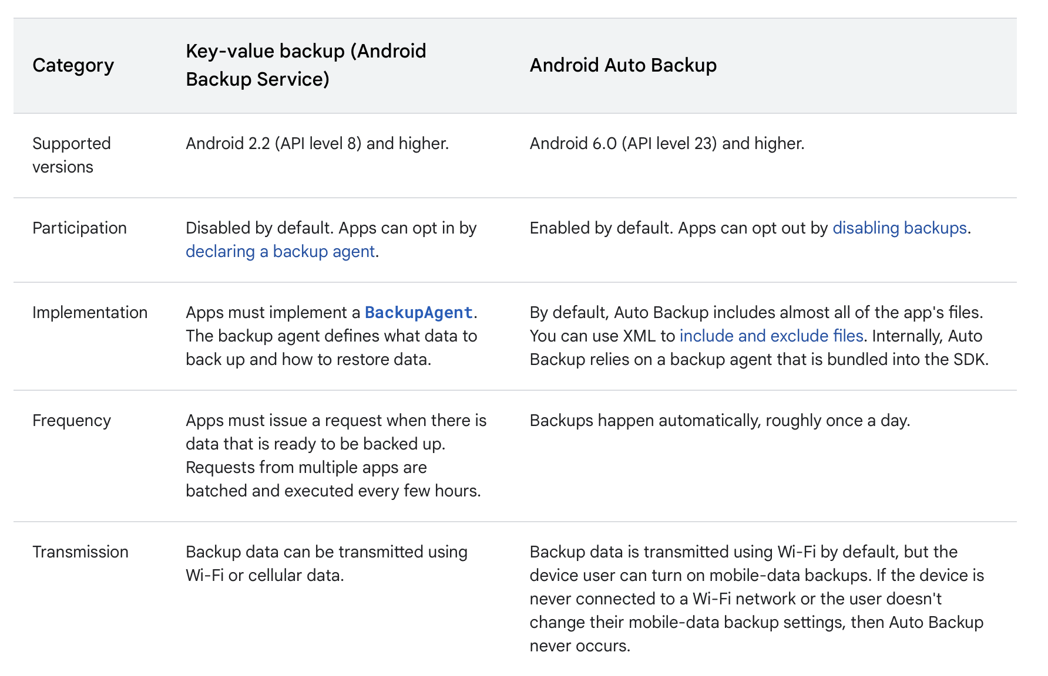
Backup & Recovery
https://developer.android.com/guide/topics/data/backup

Slide 15
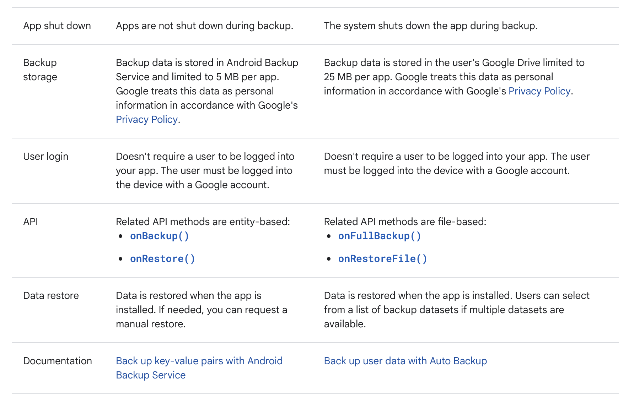
Backup & Recovery
https://developer.android.com/guide/topics/data/backup

Slide 16
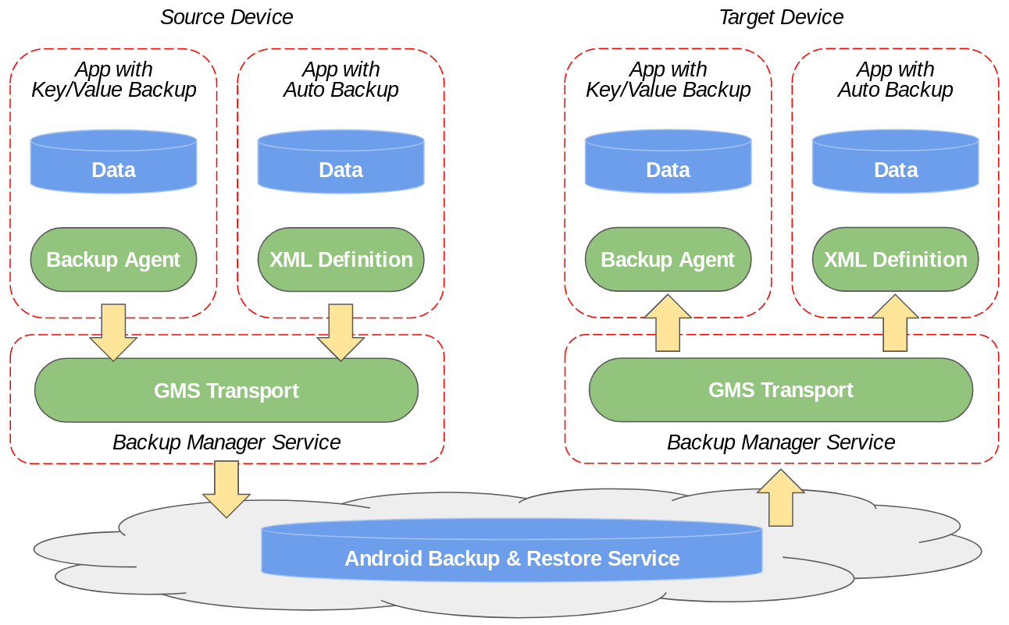
Backup & Recovery
https://developer.android.com/guide/topics/data/testingbackup
Notes:
Various pieces in the Android backup framework and how they interact with apps that support Auto Backup and key-value backup.
https://developer.android.com/guide/topics/data/testingbackup
***The following content generated by ChatGPT and verified for correctness by Dr. Ali Nazari***
Android's Backup Service, managed by the Backup Manager, determines which user-generated app data to back up based on the app's implementation of backup procedures and the criteria defined in its backup configuration. Here's how it generally works:
1. Backup Agent Implementation: The app must implement a Backup Agent, which is a component responsible for managing backup and restore operations for the app's data. This agent extends the `BackupAgent` class and overrides methods such as `onBackup()` and `onRestore()` to define what data should be backed up and how it should be restored.
2. onBackup() Method: In the `onBackup()` method of the Backup Agent, the developer specifies which data to include in the backup operation. This typically includes user-generated data such as settings, preferences, files, and other relevant information. The developer can specify which files or data structures should be included in the backup by writing the necessary code within this method.
3. Backup Configuration: Additionally, the developer can specify metadata about the backup data in the app's manifest file using the `<backup>` tag. This includes attributes such as `android:backupEnabled` and `android:fullBackupOnly`, which control whether the app participates in backups and if it should only perform full backups, respectively.
4. User Data Exclusion: Android's Backup Service also respects user privacy and excludes certain sensitive data by default, such as account credentials and other personally identifiable information. Developers can explicitly exclude additional sensitive data if needed.
5. Backup Schedule: The Backup Manager schedules periodic backups of apps' data automatically, typically when the device is idle and charging. However, users can also trigger backups manually through the device settings or other means.
6. Backup Transport Selection: The Backup Manager interacts with backup transports (e.g., Google Drive, local storage) to store the backup data securely. The selection of the backup transport depends on various factors such as the user's settings, available transports, and network conditions.
In summary, Android's Backup Service determines which user-generated app data to back up based on the developer's implementation of the Backup Agent, backup configuration specified in the manifest file, and default exclusion of sensitive data. Developers have control over what data is included in backups and can customize backup behavior according to their app's requirements.

Slide 17
Backup & Recovery
Both per-application backups, as well as full backups of all apps possible
the responsibility of selecting which data is to be backed up to the application
The application notifies the backup manager when data has changed, and the backup manager adds the application to a queue.
The BackupManager has an Application Programming Interface that developers can use

Slide 18
Backup & Recovery
Backup to various files:
Google's servers. Application needs a special API key to use this service
Enterprise backup, for managed devices
Local backup, to a device
Notes:
Recall: in Linux/Android almost everything is a file

Slide 19
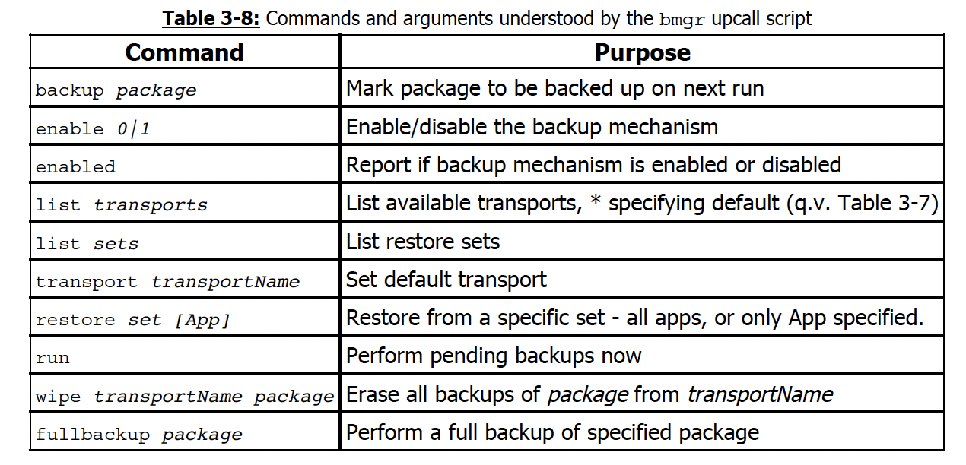
Backup & Recovery
Command Line tools:
bmgr

Slide 20
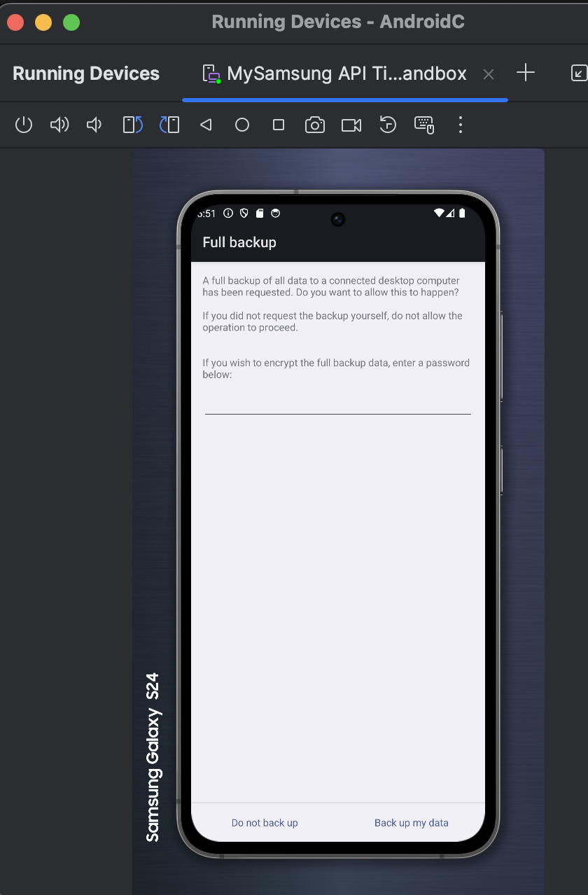
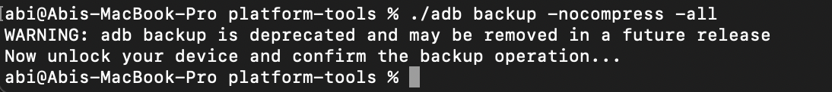
Backup & Recovery
./adb backup -all
Notes:
try it
If the user approves the backup operation, a notification informs that the backup started, and the current package progress is displayed.

Slide 21
Backup & Recovery
Recovery
System boots with an alternate boot sequence, which - rather than load the full OS UI - loads a minimal configuration
./adb reboot recovery

Slide 22
Review - Example questions
- Once init has started, it maintains system properties (T|F?).
- The Android System Properties provide a globally accessible repository of configuration settings (T|F?)
- How does Android’s Backup Service (Backup Manager) determine which user-generated app data to be backed up?
leaves it to the programmer who must use the android API (i.e., implement a BackupAgent interface) and designate specific data to be backed up
BackupManager determines changes automatically and backs-up user appsthat need a backup periodically
- Suppose you want to backup a particular user app so it can be restored on other Android devices. What kind of data should be backed up
User Generated App data
Identity and account data
Current memory state
Notes:
Content generated by ChatGPT and verified for correctness by Dr. Ali Nazari:
Android's Backup Service, managed by the Backup Manager, determines which user-generated app data to back up based on the app's implementation of backup procedures and the criteria defined in its backup configuration. Here's how it generally works:
1. Backup Agent Implementation: The app must implement a Backup Agent, which is a component responsible for managing backup and restore operations for the app's data. This agent extends the `BackupAgent` class and overrides methods such as `onBackup()` and `onRestore()` to define what data should be backed up and how it should be restored.
2. onBackup() Method: In the `onBackup()` method of the Backup Agent, the developer specifies which data to include in the backup operation. This typically includes user-generated data such as settings, preferences, files, and other relevant information. The developer can specify which files or data structures should be included in the backup by writing the necessary code within this method.
3. Backup Configuration: Additionally, the developer can specify metadata about the backup data in the app's manifest file using the `<backup>` tag. This includes attributes such as `android:backupEnabled` and `android:fullBackupOnly`, which control whether the app participates in backups and if it should only perform full backups, respectively.
4. User Data Exclusion: Android's Backup Service also respects user privacy and excludes certain sensitive data by default, such as account credentials and other personally identifiable information. Developers can explicitly exclude additional sensitive data if needed.
5. Backup Schedule: The Backup Manager schedules periodic backups of apps' data automatically, typically when the device is idle and charging. However, users can also trigger backups manually through the device settings or other means.
6. Backup Transport Selection: The Backup Manager interacts with backup transports (e.g., Google Drive, local storage) to store the backup data securely. The selection of the backup transport depends on various factors such as the user's settings, available transports, and network conditions.
In summary, Android's Backup Service determines which user-generated app data to back up based on the developer's implementation of the Backup Agent, backup configuration specified in the manifest file, and default exclusion of sensitive data. Developers have control over what data is included in backups and can customize backup behavior according to their app's requirements.

Slide 23
Review - Example questions
- Backup service can be used to perform a full backup of all apps (T|F?)
- The Generic Kernel Image
Is a single kernel binary with built-in device drivers and kernel binaries for most common Android hardware
It works with all Android devices (a specific version and higher)
The GKI loads vendor-related kernel modules during the Init process

Slide 24
Review - Example questions
- What is the Process ID of the Init process in Android?
.....
- Where is the bootstrap loader (boot loader) stored?
RAM
Flash memory firmware
Google Cloud
Which configuration file tells the operating system to mount each partition containing a file system at a specified location (mount point) and to use mount options such as read-only.
fstab* somewhere in the vendor partition
init.rc
....... a file system is making the file system available for use by the system and its users.
Mounting
Encrypting
Backing up
Indexing
Notes:
In Android, the configuration file responsible for specifying how partitions containing file systems should be mounted is the `fstab` file. The `fstab` file (short for file system table) is located in the `/etc` directory of the Android file system.
Similar to its counterpart in Unix-like operating systems, the `fstab` file in Android defines the mount points for various partitions or devices, along with options such as whether to mount them read-only or read-write, file system type, and other parameters. This file is read by the Android operating system during the boot process to automatically mount the specified file systems at their designated mount points.
In Android, aside from being found in the `/etc` directory, the `fstab` file might also be located in the following directories:
1. `/vendor/etc`: This directory contains device-specific configurations, including the `fstab` file for certain Android devices.
2. `/system/etc`: On some Android devices, the `fstab` file can be found in this directory, particularly on older versions or devices with modified system configurations.
These locations may vary depending on the specific Android device and its manufacturer.

